Slide 1

Dynamic Analysis of Gyroscopic System
By
Bharat Anant (224103410)
Kudipudi Bhanu Sukruth (224103417)
Himanshu Lahare (224103414)
Group-17
M.Tech in MACHINE DESIGN
ME-531 Mechanical Vibrations
Prof. S.K.Dwivedy
Department of Mechanical Engineering
Indian Institute of Technology Guwahati

Slide 2
References
S.No | Title | Author | Year
1 | Stability of non-conservative linear discrete gyroscopic systems. | S. M. Yang C. D. Mote | 20 July 1990
2 | Vibration analysis of a rotating system due to the effect of ball Bearing Waviness. | Gunhee Jang, Seong-Weon Jeong | 20 January 2003
3 | Non-synchronous rotating damping effects in gyroscopic Rotating systems. | Eugenio Brusa, Giacomo Zolfini | 2 February 2004
4 | Natural frequencies of combined gyroscopic systems. | B. Yang | 3 June 1991
5 | Dynamic analysis of unbalance in rotating machinery. | Akash Rajan, Jayaraj Kochupillai, Shijukumar, P.K. Shajan | July 2014

Slide 3
ABSTRACT
Rotating machines can develop inertia effects and this inertia effects in rotating structures are usually caused by gyroscopic moment introduced by the precise motions of the vibrating rotor as it spins.
As spin velocity increases, the gyroscopic moment acting on the rotor becomes critical.
It can be analysed to improve the design and decrease the possibility of failure.
This paper focuses on dynamic unbalance detection in rotating machinery by gyroscopic effects, mass effects.

Slide 4
INTRODUCTION
The study of the mechanical signature or the vibration spectrum of a rotating machine allows to identify operating problems even before they become dangerous. The symptoms of a problem that is developing and allows the required counter measures to be taken in time. The objective is to study the rotor dynamic aspects of rotors and develop an understanding of critical speed, the effects of mass in a simple model and Rotor dynamics analysis by incorporating whirl, gyroscopic effects.

Slide 5
In modal analysis, the natural frequencies are evaluated in order to decide the critical speeds and mode shapes of the rotor. The process is repeated for different rotational speeds. Study of a simple rotating shaft (Jeffcott rotor) with a centrally mounted disc, in order to find the gyroscopic effects and mass effects in the system. To understand the gyroscopic effects a system with four degree of freedom is considered .i.e. two lateral and two rotational motion.

Slide 6
Gyroscopic effects:
The perpendicular rotation or precession motion is applied to the spinning rotor about its spin axis, a reaction moment appears and this effect is described as gyroscopic effect.
The interaction of the angular momentum of the rotating rotor and the wobbling motion introduce gyroscopic effect. The gyroscopic effect is only observed for modes which includes an angular (wobbling) component.
A frequency map, is a graphically way to illustrate the influence of the gyroscopic effect on natural frequencies.

Slide 7
Critical Speed:
The speed at which excitation frequency equal to natural frequency. The critical speed can be identified with both a modal analysis and a forced response analysis.
Critical speed should always be avoided in any machines parts because otherwise significant vibrations may occur. These vibrations are the result of a resonant condition.
Rotor Unbalance:
When excessive, can lead to fatigue of machine components. In extreme cases, it can cause wear in bearings or internal rubs that can damage seals and degrade machine performance.
Unbalance can produce high rotor and casing vibration, and it can produce vibration in foundation and piping systems.

Slide 8
Static Unbalance:
All the unbalanced masses lie in a single plane resulting in an unbalance of single radial force.
Static unbalance can be detected by placing the shaft between two horizontal rails and allowing the shaft to naturally roll to the position at which the unbalance is below the shaft axis.
Dynamic Unbalance:
This is when the unbalanced masses lie in more than one plane. The unbalance has to be detected by rotating the shaft and measuring the unbalance.
The machine for carrying out this detection are called ‘balancing machines’ and consist of spring mounted bearings that support the shaft.

Slide 9
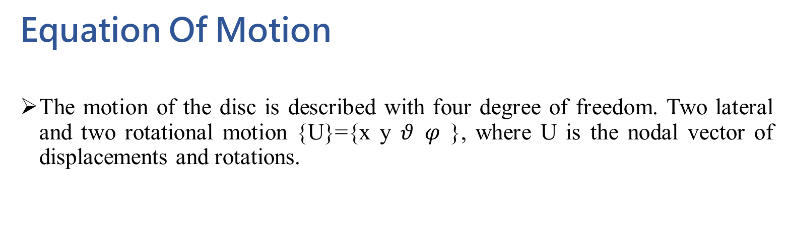
MATHEMATICAL MODEL
Equation Of Motion
The motion of the disc is described with four degree of freedom. Two lateral and two rotational motion {U}={x y $θ φ$ }, where U is the nodal vector of displacements and rotations.
Lateral Modes The disc has a mass m and the centre of gravity offset from the shaft centre is defined as eccentricity ε as shown in figure. It is assumed that the damping of the shaft is zero.

Slide 10
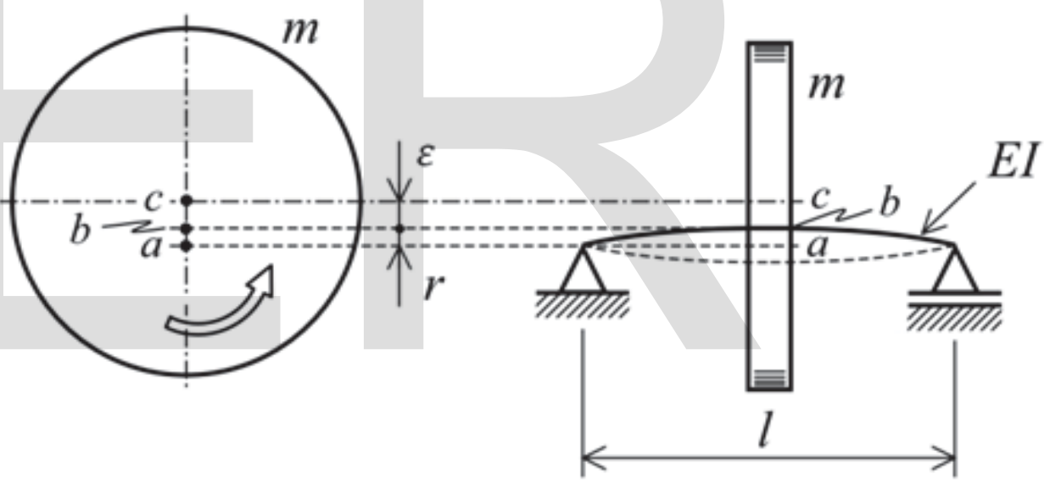
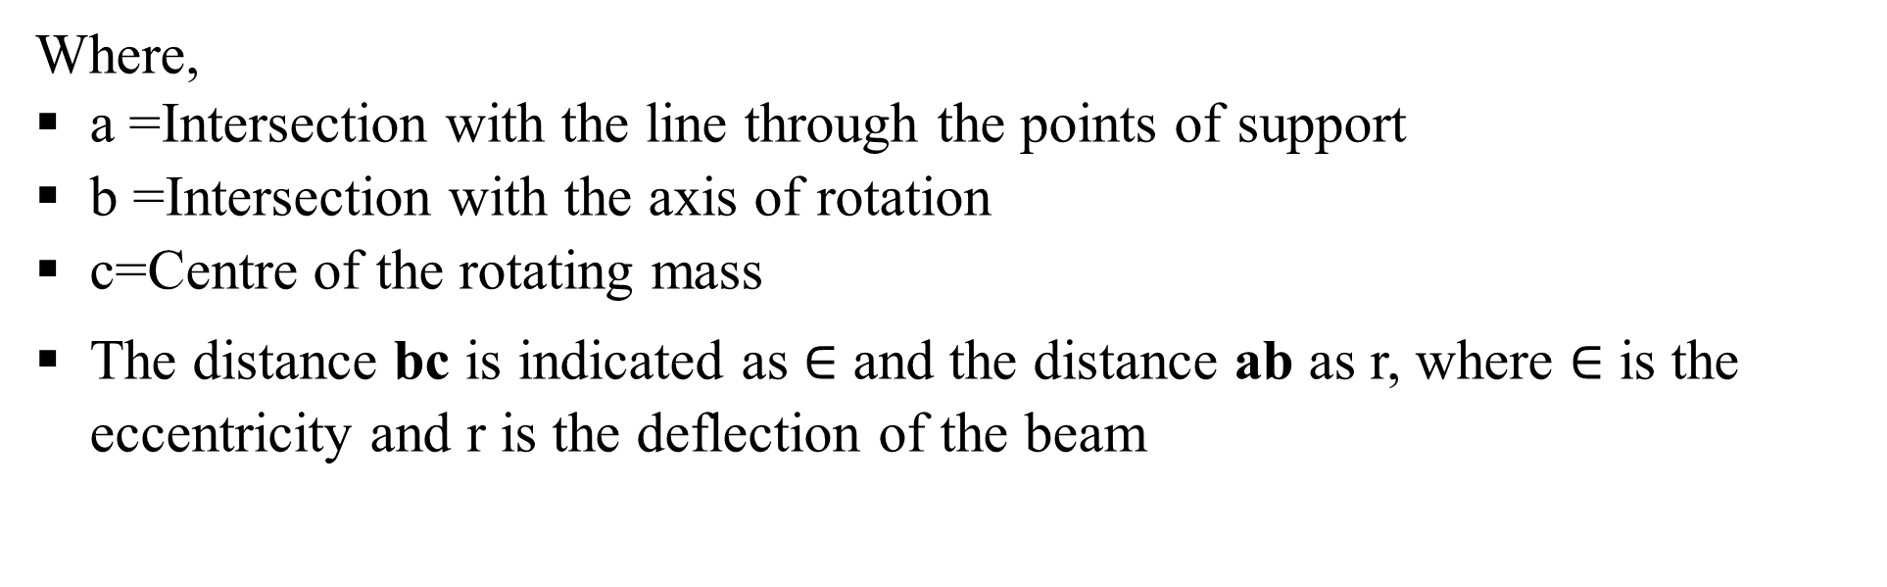
Where,
a =Intersection with the line through the points of support
b =Intersection with the axis of rotation
c=Centre of the rotating mass
The distance bc is indicated as $∈$ and the distance ab as r, where $∈$ is the eccentricity and r is the deflection of the beam

Slide 11
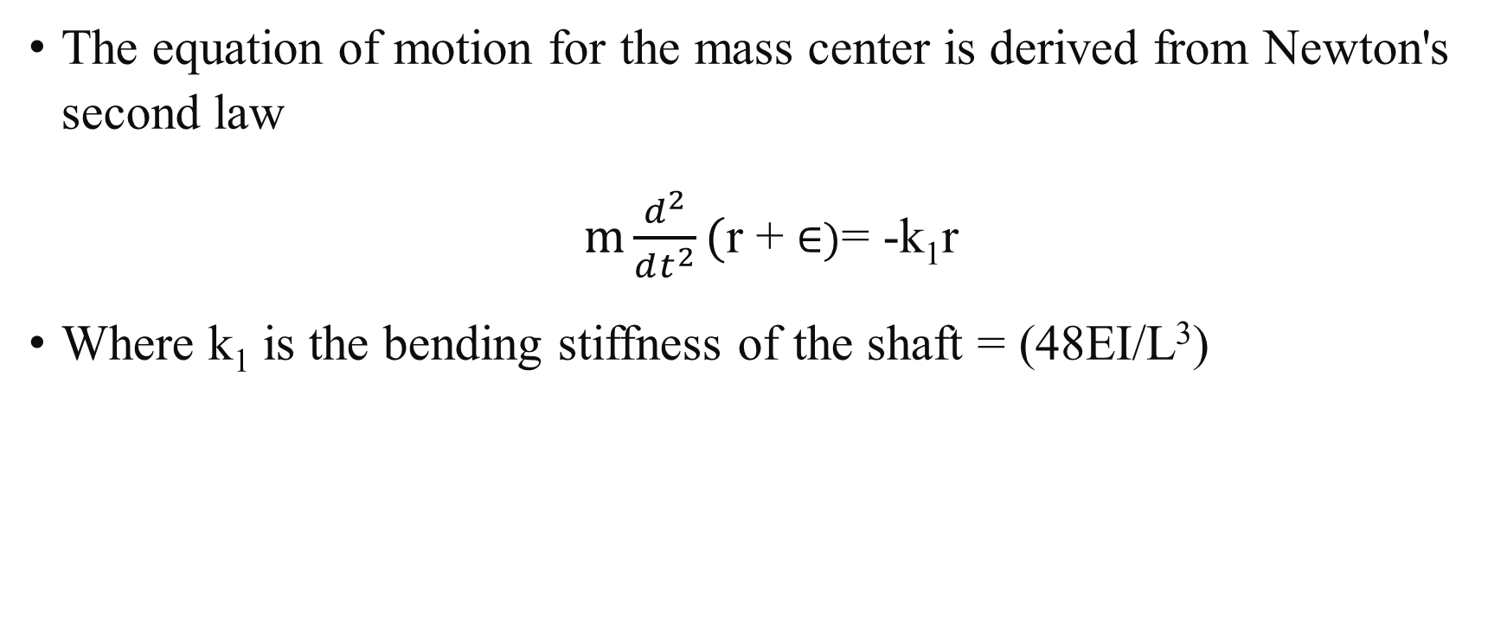
1) Equation Of Motion – Linear (x-y) Coordinates :
The equation of motion for the mass center is derived from Newton's second law
$m\frac{d^{2}}{dt^{2}}($r + $∈)$= -k₁r
Where k₁ is the bending stiffness of the shaft = (48EI/L³)

Slide 12
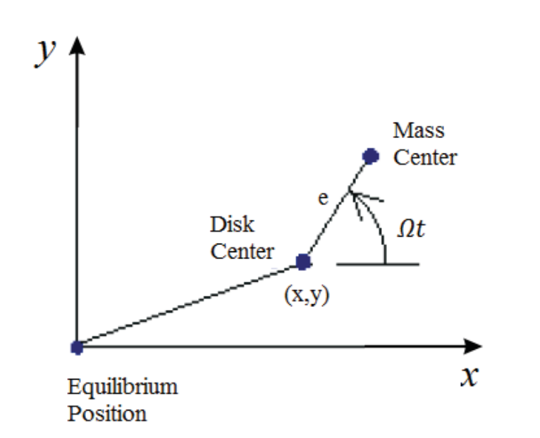
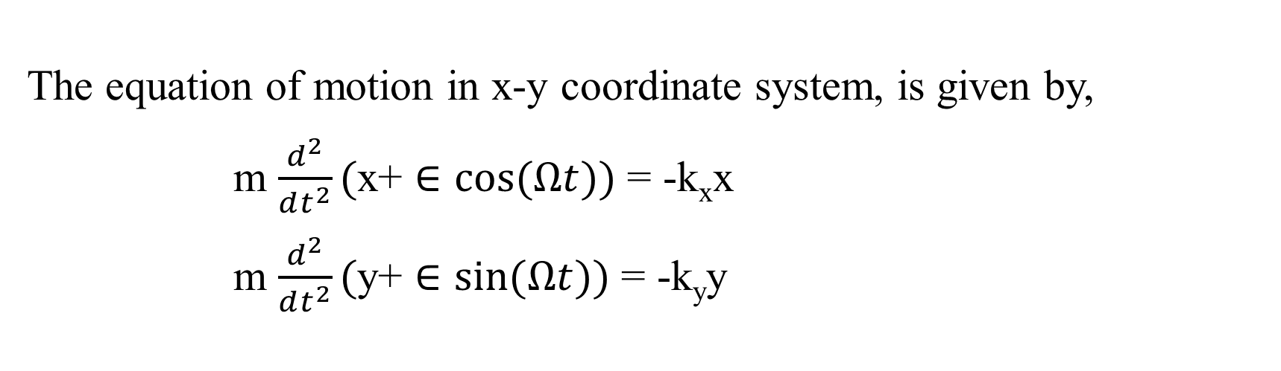
Figure : The position of the mass centre expressed in the x-y coordinate system
The equation of motion in x-y coordinate system, is given by,
m $\frac{d^{2}}{dt^{2}}($x+ $∈cos⁡(Ωt))$ = -k_{x}x
m $\frac{d^{2}}{dt^{2}}($y+ $∈sin⁡(Ωt))$ = -k_{y}y

Slide 13
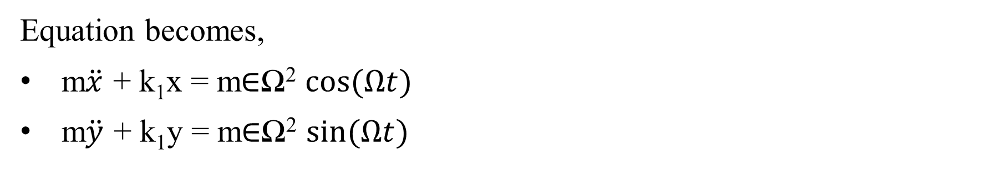
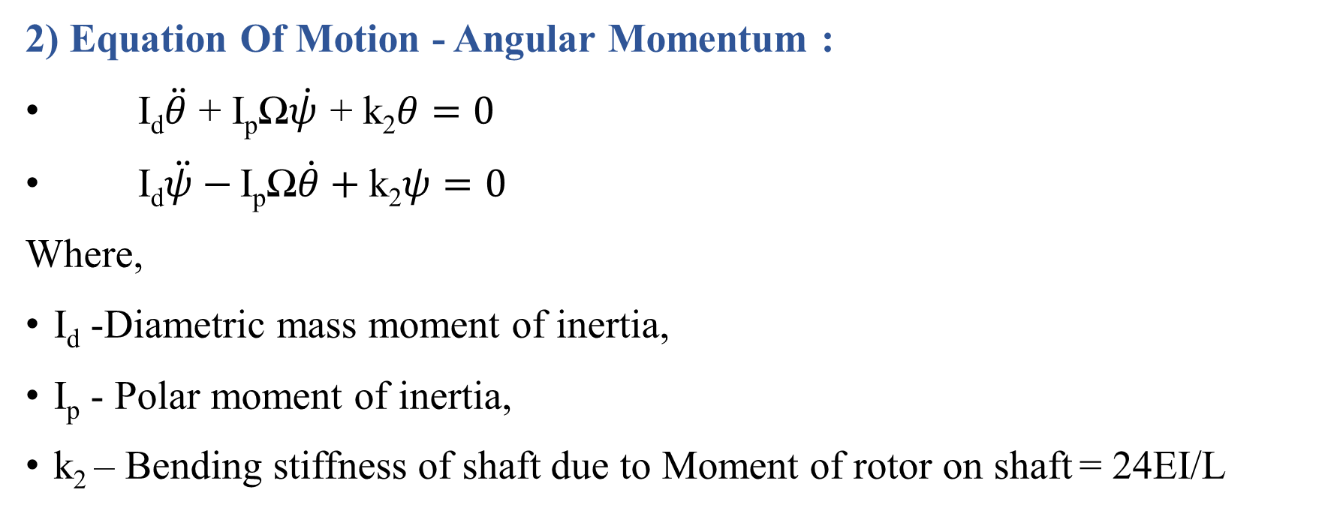
Equation becomes,
m$\ddot{x}$ + k₁x = m$∈$Ω² $cos⁡(Ωt)$
m$\ddot{y}$ + k₁y = m$∈$Ω² $sin⁡(Ωt)$
2) Equation Of Motion - Angular Momentum :
I_{d}$\ddot{θ}$ + I_{p}Ω$\dot{ψ}$ + k₂$θ=0$
I_{d}$\ddot{ψ}−$ I_{p}Ω$\dot{θ}+$k₂$ψ=0$
Where,
I_{d} -Diametric mass moment of inertia,
I_{p} - Polar moment of inertia,
k₂ – Bending stiffness of shaft due to Moment of rotor on shaft = 24EI/L

Slide 14
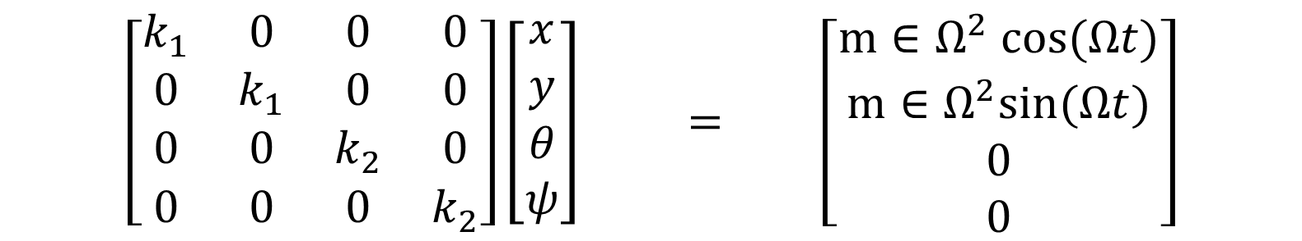
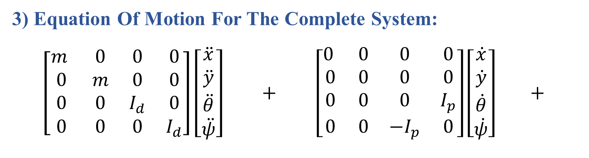
3) Equation Of Motion For The Complete System:
$$\left[\begin{matrix}m & 0 & 0 & 0 \\ 0 & m & 0 & 0 \\ 0 & 0 & I_{d} & 0 \\ 0 & 0 & 0 & I_{d}\end{matrix}\right]\left[\begin{matrix}\ddot{x} \\ \ddot{y} \\ \ddot{θ} \\ \ddot{ψ}\end{matrix}\right] + \left[\begin{matrix}0 & 0 & 0 & 0 \\ 0 & 0 & 0 & 0 \\ 0 & 0 & 0 & I_{p} \\ 0 & 0 & −I_{p} & 0\end{matrix}\right]\left[\begin{matrix}\dot{x} \\ \dot{y} \\ \dot{θ} \\ \dot{ψ}\end{matrix}\right] +$$
$$\left[\begin{matrix}k_{1} & 0 & 0 & 0 \\ 0 & k_{1} & 0 & 0 \\ 0 & 0 & k_{2} & 0 \\ 0 & 0 & 0 & k_{2}\end{matrix}\right]\left[\begin{matrix}x \\ y \\ θ \\ ψ\end{matrix}\right] = \left[\begin{matrix}m∈Ω^{2} cos⁡(Ωt) \\ m∈Ω^{2}sin⁡(Ωt) \\ 0 \\ 0\end{matrix}\right]$$

Slide 15
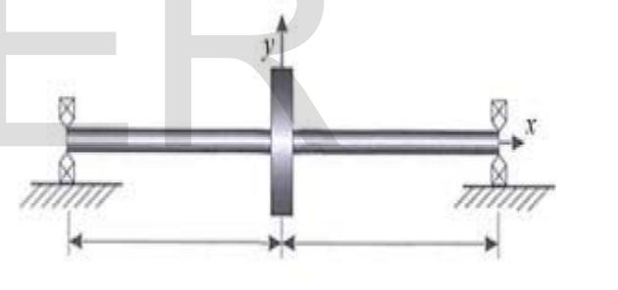
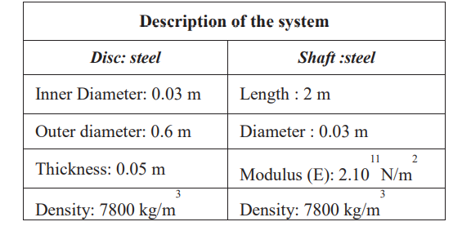
Simple Rotor Model

Slide 16
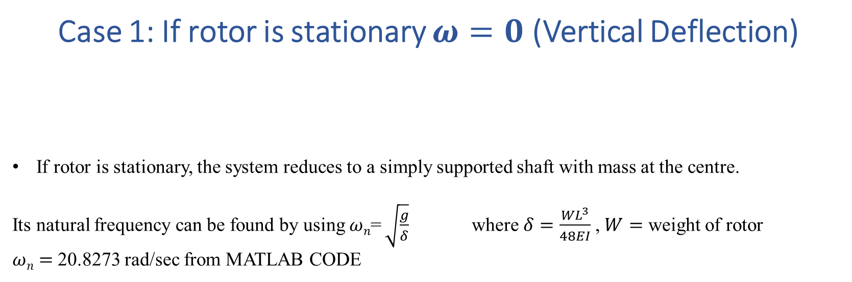
Case 1: If rotor is stationary $ω=0$ (Vertical Deflection)
If rotor is stationary, the system reduces to a simply supported shaft with mass at the centre.
Its natural frequency can be found by using $ωn$= $\sqrt{\frac{g}{δ}}$ where $δ=\frac{WL^{3}}{48EI}$ , $W=$ weight of rotor
$ωn=$20.8273 rad/sec from MATLAB CODE

Slide 17
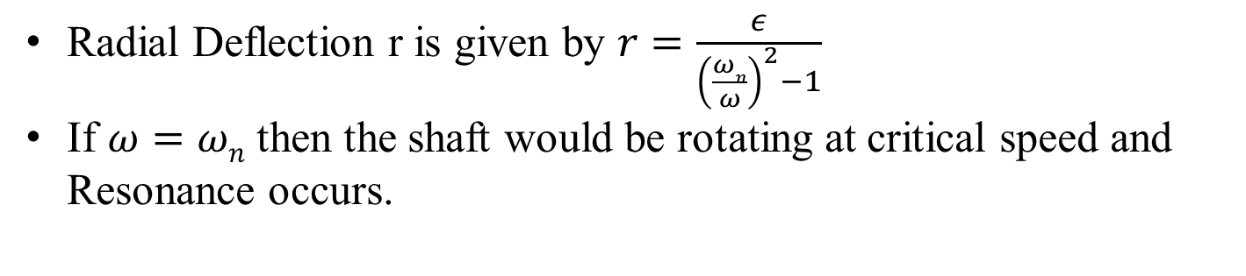
Case 2: When rotor is spinning and
there is no Gyroscopic Effect (Whirling of Shaft)
Radial Deflection r is given by $r=\frac{ε}{{\left(\frac{ωn}{ω}\right)}^{2}−1}$
If $ω=ωn$ then the shaft would be rotating at critical speed and Resonance occurs.

Slide 18
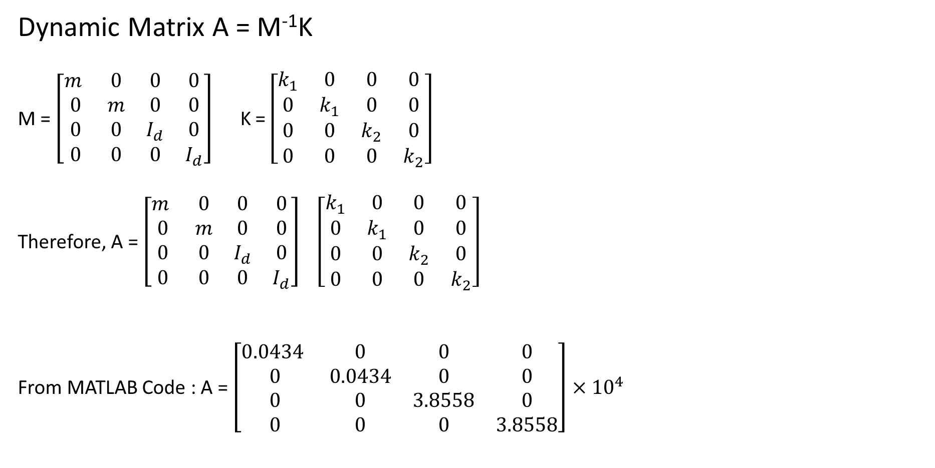
Case 3 : Modal Analysis
Dynamic Matrix A = M⁻¹K
M = $\left[\begin{matrix}m & 0 & 0 & 0 \\ 0 & m & 0 & 0 \\ 0 & 0 & I_{d} & 0 \\ 0 & 0 & 0 & I_{d}\end{matrix}\right]$ K = $\left[\begin{matrix}k_{1} & 0 & 0 & 0 \\ 0 & k_{1} & 0 & 0 \\ 0 & 0 & k_{2} & 0 \\ 0 & 0 & 0 & k_{2}\end{matrix}\right]$
Therefore, A = $\left[\begin{matrix}m & 0 & 0 & 0 \\ 0 & m & 0 & 0 \\ 0 & 0 & I_{d} & 0 \\ 0 & 0 & 0 & I_{d}\end{matrix}\right]$ $\left[\begin{matrix}k_{1} & 0 & 0 & 0 \\ 0 & k_{1} & 0 & 0 \\ 0 & 0 & k_{2} & 0 \\ 0 & 0 & 0 & k_{2}\end{matrix}\right]$
From MATLAB Code : A = $\left[\begin{matrix}0.0434 & 0 & 0 & 0 \\ 0 & 0.0434 & 0 & 0 \\ 0 & 0 & 3.8558 & 0 \\ 0 & 0 & 0 & 3.8558\end{matrix}\right]$ $×{10}^{4}$
-1

Slide 19
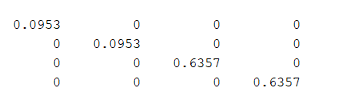
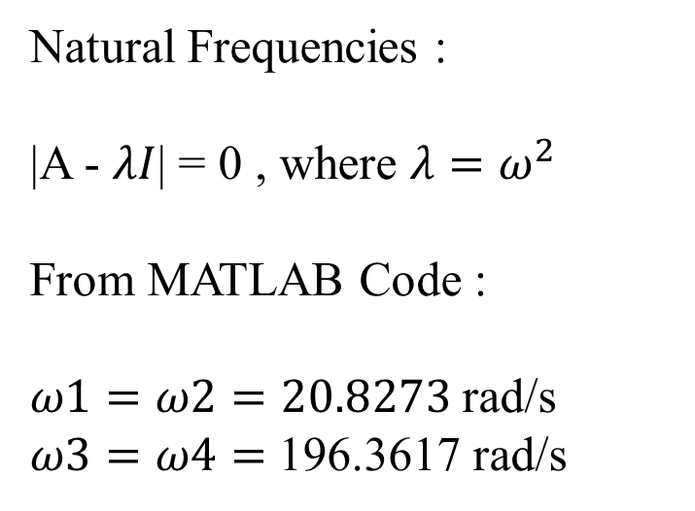
Natural Frequencies :
|A - $λI$| = 0 , where $λ=ω^{2}$
From MATLAB Code :
$ω1=ω2=20.8273$ rad/s
$ω3=ω4=$ 196.3617 rad/s
Mode Shapes for 4-DOF:

Slide 20
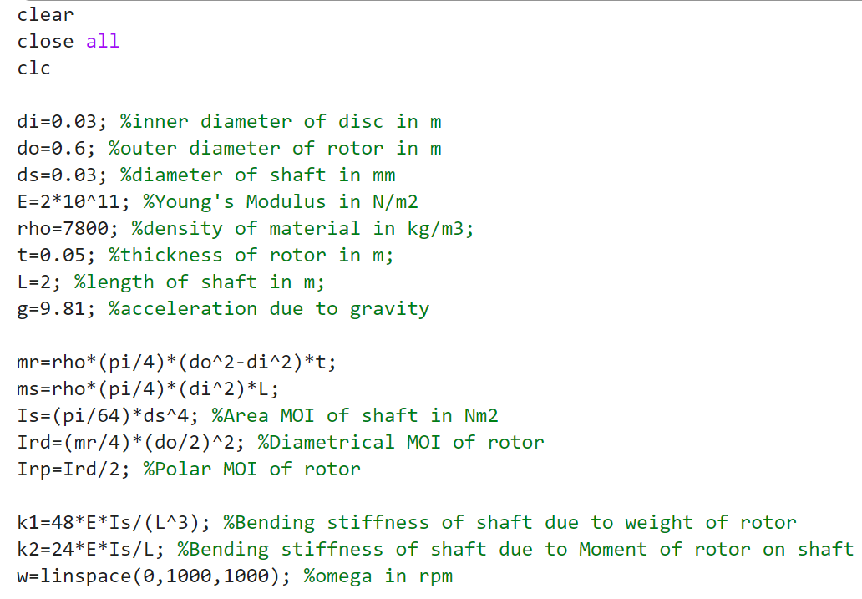
MATLAB CODE

Slide 21
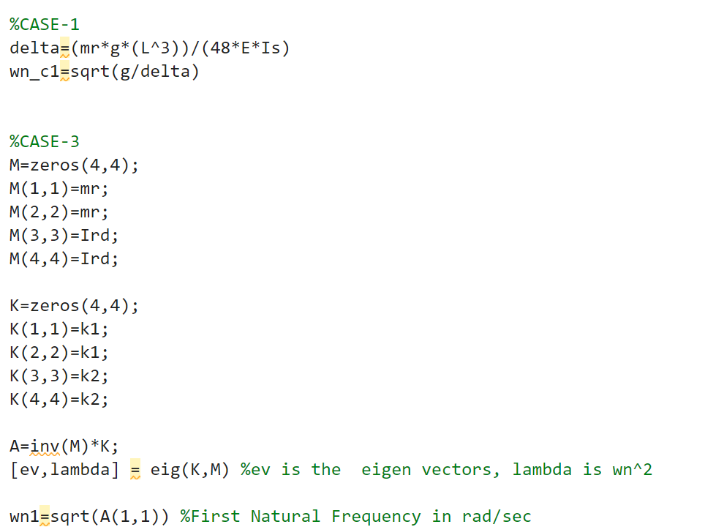

Slide 22
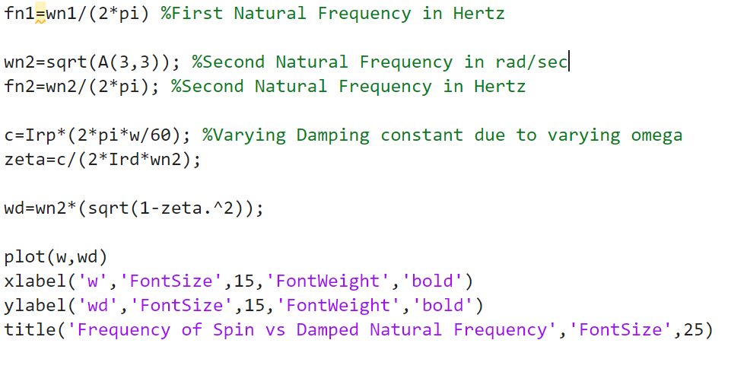

Slide 23
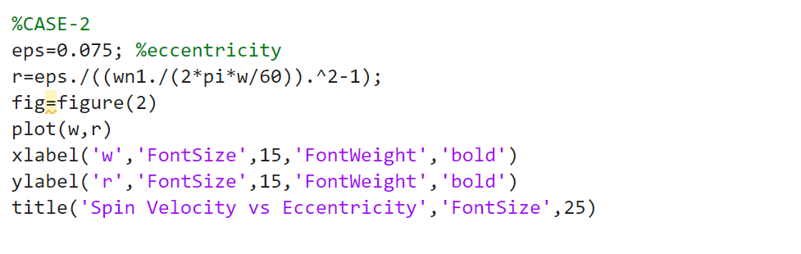

Slide 26
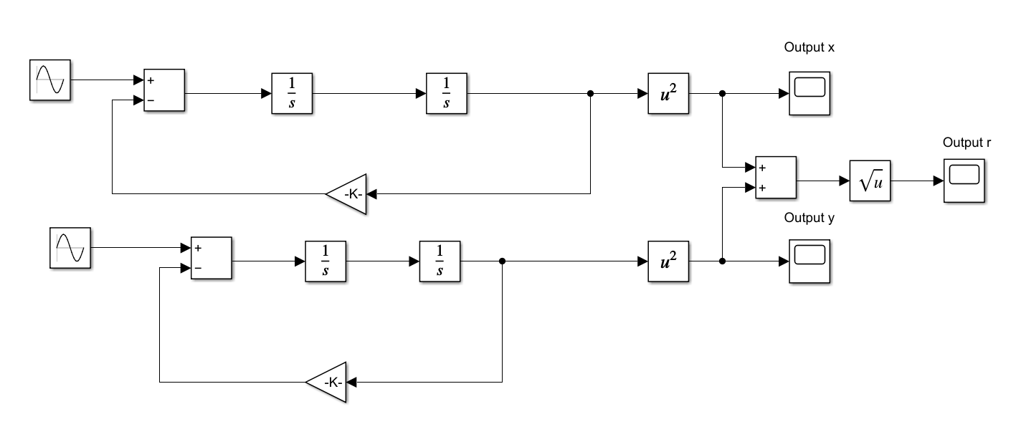
SIMULINK MODEL
Model for finding radial position of Centre of Mass of Rotor

Slide 27
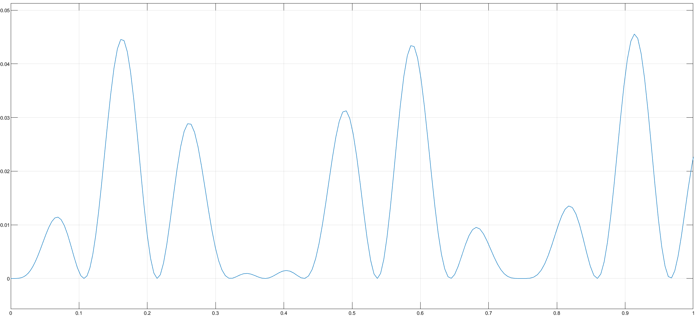
Simulink Output of x position

Slide 28
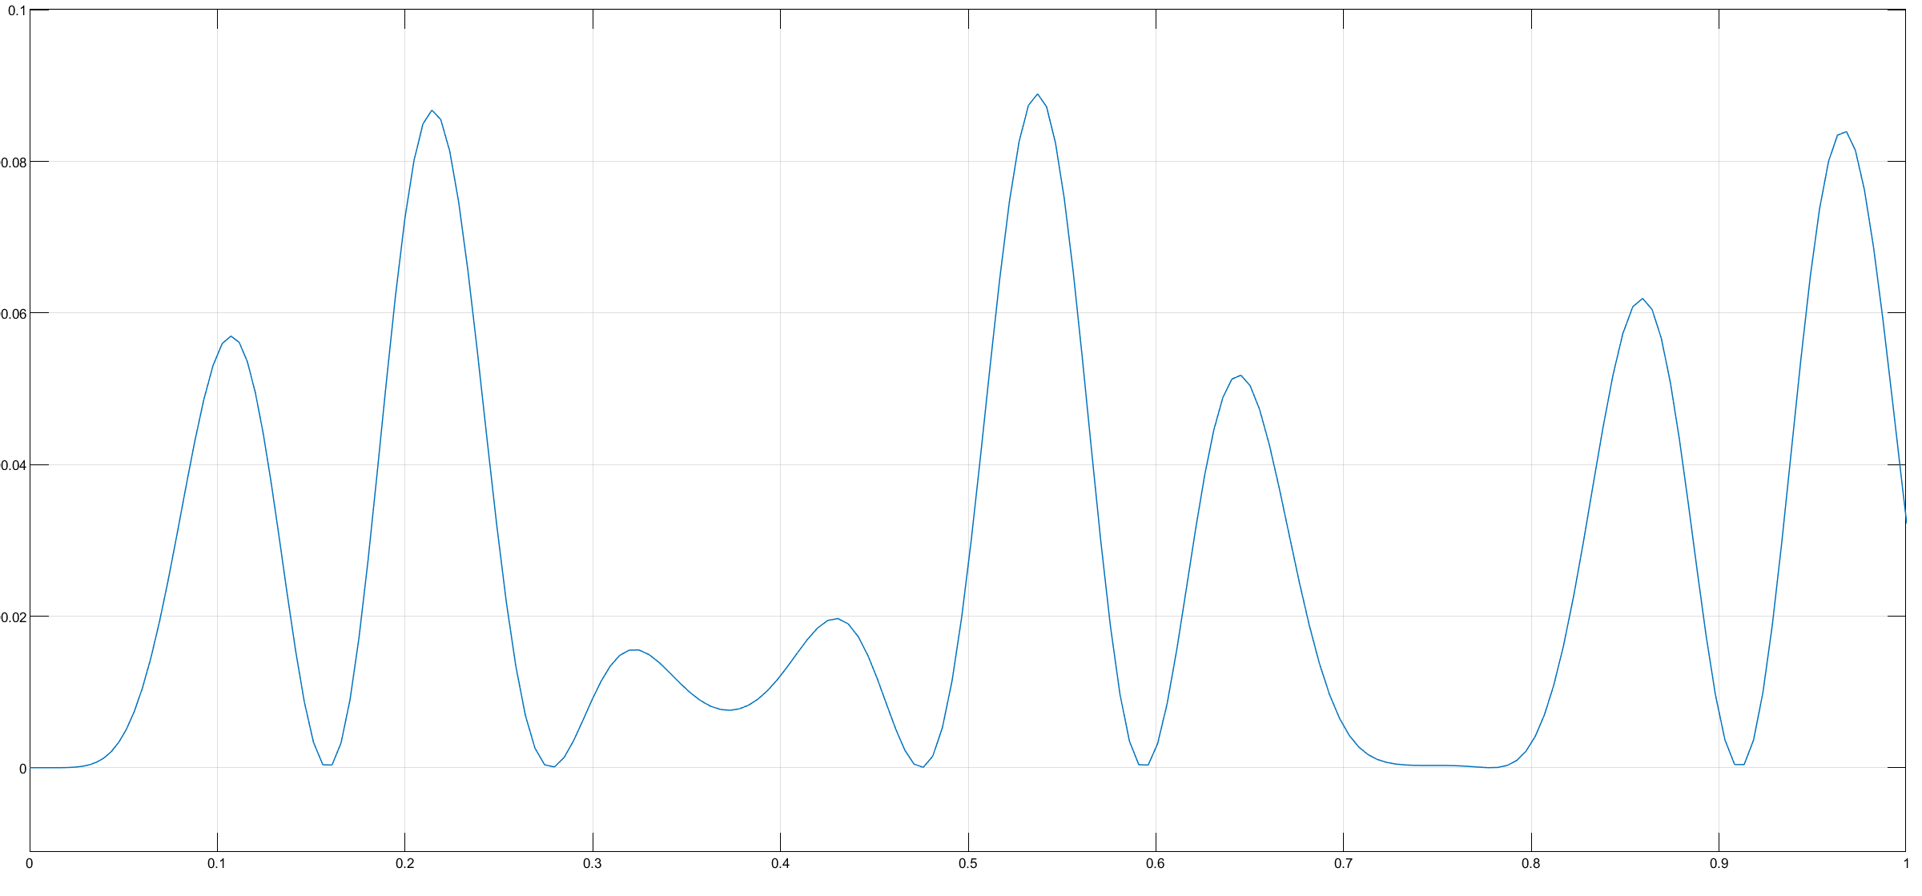
Simulink Output of y position

Slide 29
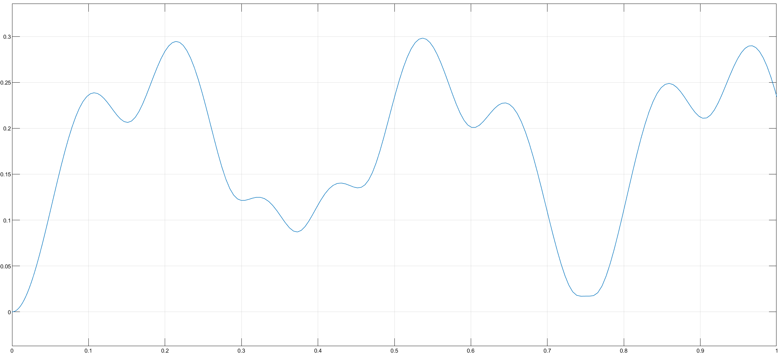
Simulink Output of radial position r

Slide 30
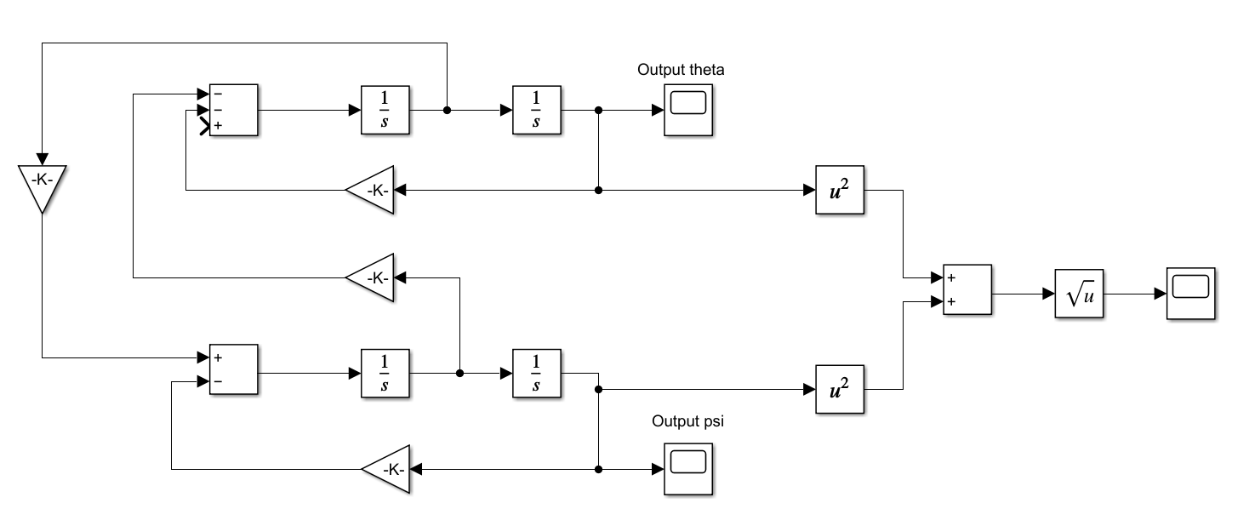
Model for finding orientations

Slide 31
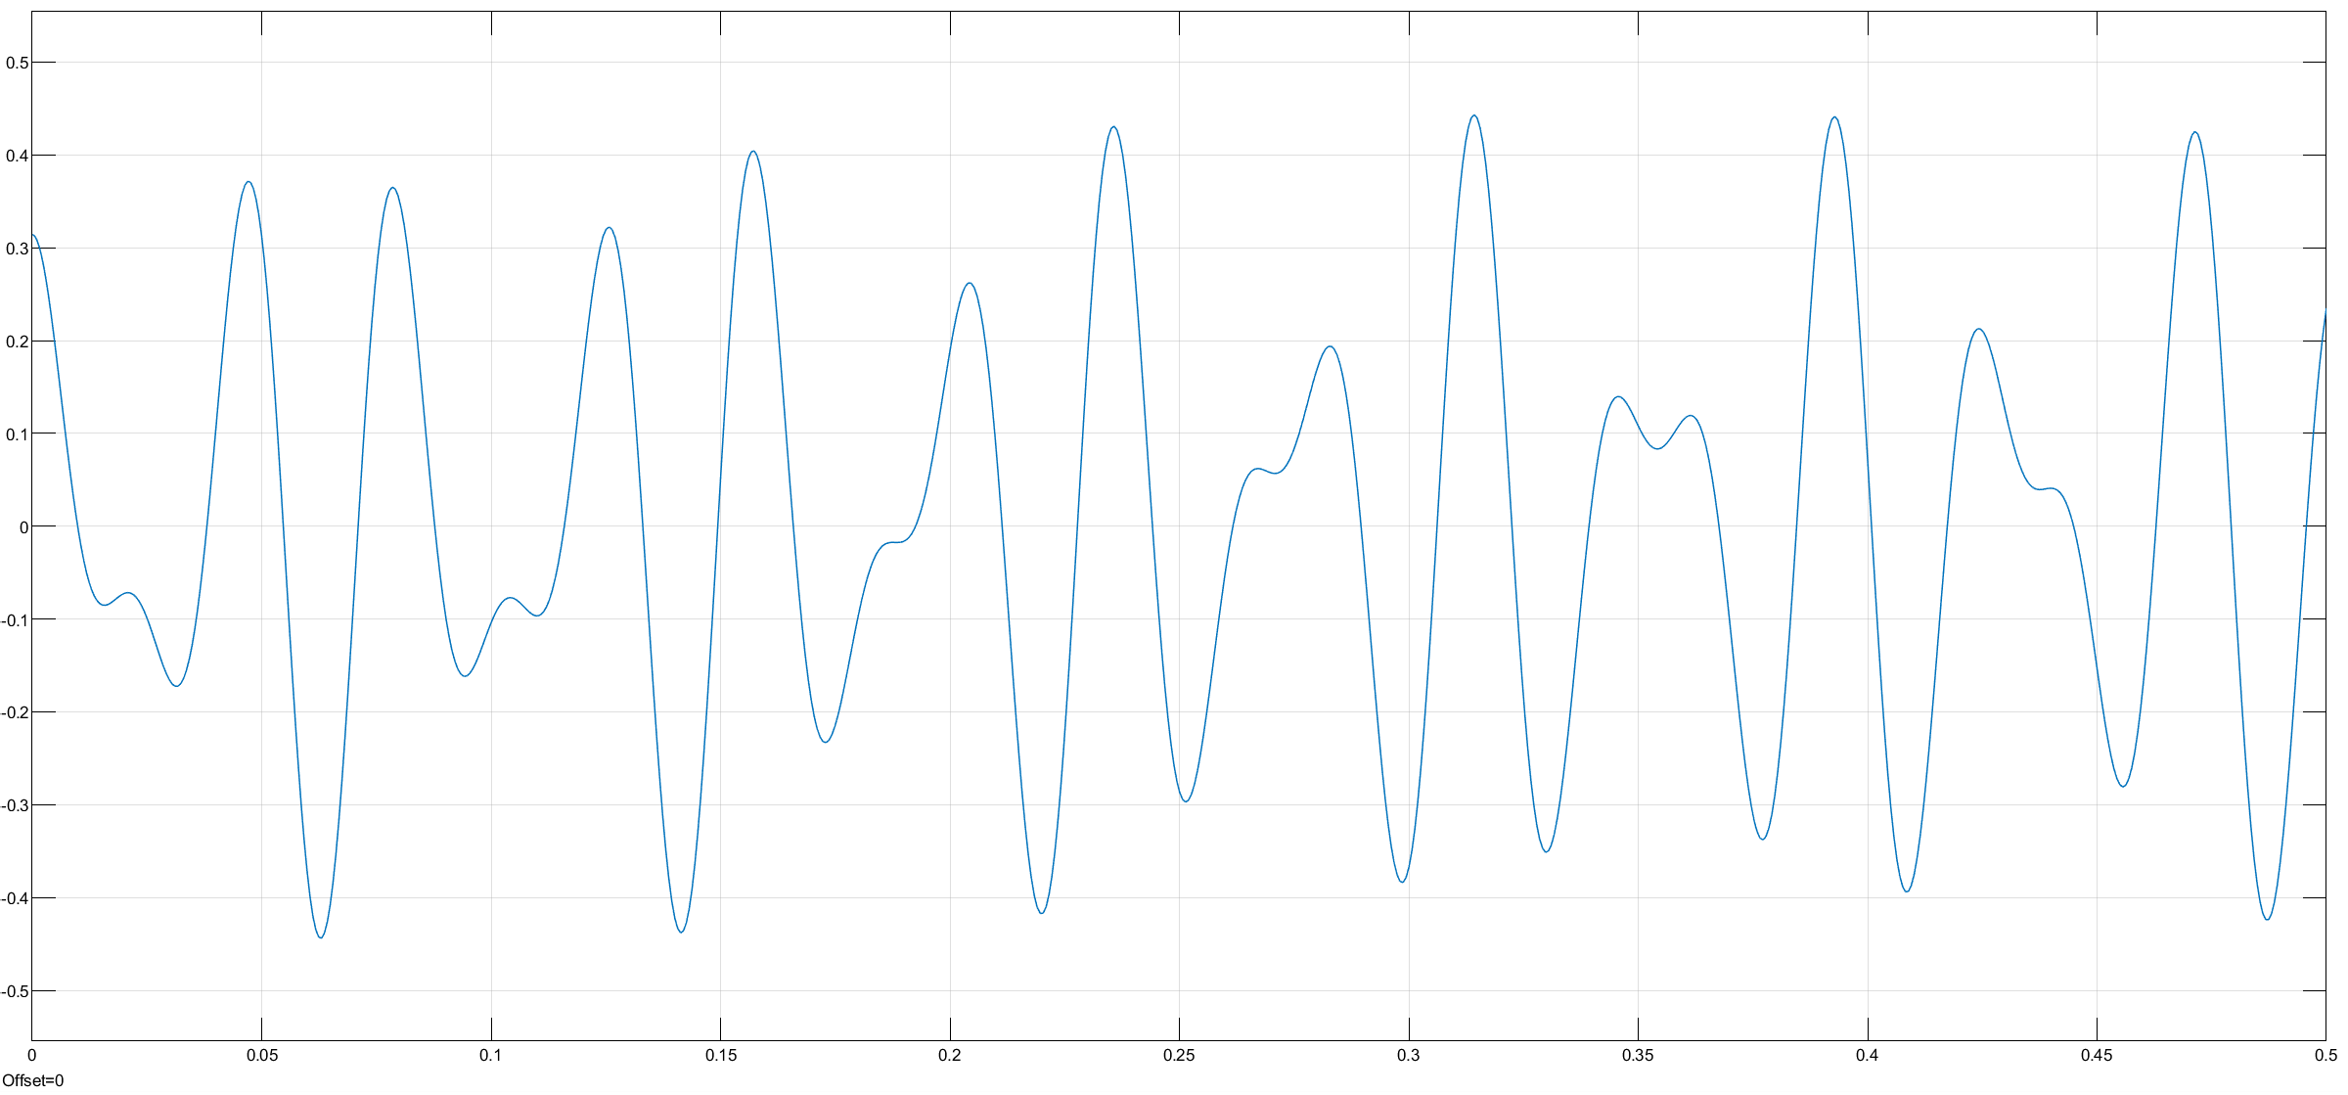

Simulink Output of $θ$

Slide 32
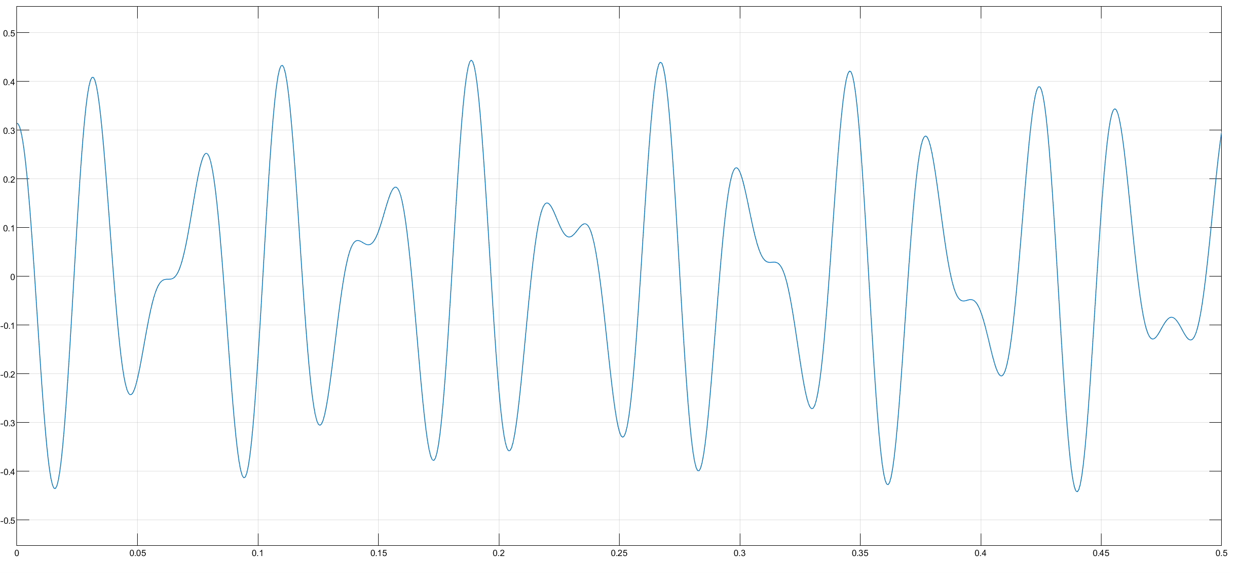

Simulink Output of $ψ$

Slide 33
Results and Discussions
Three Possible Cases of Rotor Dynamics were discussed:
CASE-1: Static Rotor
CASE-2: Whirling of Shaft (No Gyroscopic Effect)
CASE-3: Whirling of Shaft (with Gyroscopic Effect)
Modal Analysis for Case-3 is done using MATLAB
SIMULINK model was developed for Case-3 and graphs were plotted for the same.

Slide 34
THANK YOU

